Slide 1
Software Engineering
Software Engineering
Software Myths

Slide 2
What is Software?
Set of instructions, data or programs used to operate computers and execute specific tasks
Set of programs, procedures, and routines associated with the operation of a computer system
Instructions that when executed provide desired features, function and performance
Document that describe operation and use of program

Slide 3
The economies of all developed nations are dependent on software
Expenditure on software represents a significant fraction of the National Income in all developed countries
Software costs often dominate computer system cost
Three main Types –
System Software
Application Software
Network Software

Slide 4
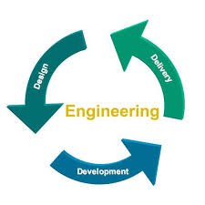
What is Engineering?
The application of scientific and mathematical principles to practical ends
Profession of applying scientific principles to the design, construction and maintenance

Slide 5
Software Engineering
Establishment and use of sound engineering principles to produce software that is reliable and works efficiently
Application of systematic, disciplined and quantifiable approach to development, operation and maintenance of software
Engineering discipline that concerned with all aspects of software production

Slide 6
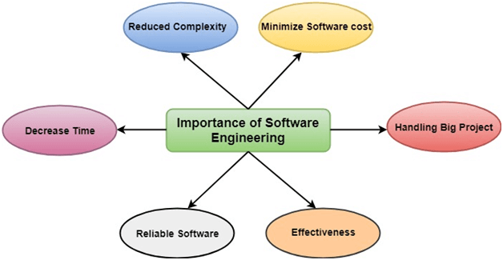
Importance of Software Engineering –

Slide 7
Reduces complexity:
Big software - complicated and challenging to progress
Software engineering has a great solution to reduce the complication of any project
Software engineering follows modularized approach for solving the problem
To minimize software cost:
Software needs a lot of hard work, a lot of manpower is required to develop software with a large number of codes
But in software engineering, programmers project everything and decrease all those things that are not needed.

Slide 8
To decrease time:
Anything that is not made according to the project always wastes time. And if you are making great software, then you may need to run many codes to get the definitive running code. This is a very time-consuming procedure, and if it is not well handled, then this can take a lot of time. So if you are making your software according to the software engineering method, then it will decrease a lot of time.
Reliable software:
Software should be secure
If any bugs come in the software, the company is responsible for solving all these bugs. Because in software engineering, testing and maintenance are given, so there is no worry of its reliability.

Slide 9
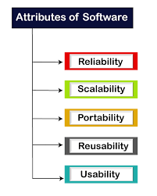
Effectiveness:
Effectiveness comes if anything has made according to the standards
So Software becomes more effective in the act with the help of software engineering

Slide 10
Objectives of Software Engineering –
Maintainability = It should be feasible for the software to evolve to meet changing requirements.
Efficiency = The software should not make wasteful use of computing devices such as memory, processor cycles, etc.
Correctness = A software product is correct if the different requirements as specified in the SRS document have been correctly implemented.
Reusability = A software product has good reusability if the different modules of the product can easily be reused to develop new products.

Slide 11
Testability = Here software facilitates both the establishment of test criteria and the evaluation of the software with respect to those criteria.
Reliability = It is an attribute of software quality. The extent to which a program can be expected to perform its desired function, over an arbitrary time period.
Portability = In this case, the software can be transferred from one computer system or environment to another.
Adaptability = In this case, the software allows differing system constraints and the user needs to be satisfied by making changes to the software.
Interoperability = Capability of 2 or more functional units to process data cooperatively.

Slide 12
Software Myths
“misleading attitudes that have caused serious problem”
Managers Myth
Developers Myth
Customers Myth

Slide 13
Managers Myth =
Myth-1:
We already have a book that's full of standards and procedures for building software, won't that provide my people with everything they need to know?
Reality:
The book of standards may very well exist, but is it used? Are software practitioners aware of its existence? Does it reflect modern software engineering practice? Is it complete? Is it streamlined to improve time to delivery while still maintaining a focus on quality? In many cases, the answer to all of these questions is "no."

Slide 14
Myth-2:
My people have state-of-the-art software development tools, after all, we buy them the newest computers.
Reality:
It takes much more than the latest model mainframe, workstation, or PC to do high-quality software development. Computer-aided software engineering (CASE) tools are more important than hardware for achieving good quality and productivity, yet the majority of software developers still do not use them effectively

Slide 15
Myth-3:
If we get behind schedule, we can add more programmers and catch up (sometimes called the Mongolian horde concept).
Reality:
Software development is not a mechanistic process like manufacturing, "adding people to a late software project makes it later."

Slide 16
Developer Myth =
Myth-1:
Once we write the program and get it to work, our job is done.
Reality:
Someone once said that "the sooner you begin 'writing code', the longer it'll take you to get done." Industry data indicate that between 60 and 80 percent of all effort expended on software will be expended after it is delivered to the customer for the first time.

Slide 17
Myth-2:
Until I get the program "running" I have no way of assessing its quality.
Reality:
One of the most effective software quality assurance mechanisms can be applied from the inception of a project—the formal technical review. Software reviews are a "quality filter" that have been found to be more effective than testing for finding certain classes of software defects

Slide 18
Myth-3:
The only deliverable work product for a successful project is the working program.
Reality:
A working program is only one part of a software configuration that includes many elements. Documentation provides a foundation for successful engineering and, more important, guidance for software support

Slide 19
Myth-4:
Software engineering will make us create voluminous and unnecessary documentation and will invariably slow us down.
Reality:
Software engineering is not about creating documents. It is about creating quality. Better quality leads to reduced rework. And reduced rework results in faster delivery times

Slide 20
Customer Myth =
Myth-1:
A general statement of objectives is sufficient to begin writing programs— we can fill in the details later.
Reality:
A poor up-front definition is the major cause of failed software efforts. A formal and detailed description of the information domain, function, behavior, performance, interfaces, design constraints, and validation criteria is essential. These characteristics can be determined only after thorough communication between customer and developer.

Slide 21
Myth-2:
Project requirements continually change, but change can be easily accommodated because software is flexible.
Reality:
It is true that software requirements change, but the impact of change varies with the time at which it is introduced.

